Slide 1
UNIT 8 STRUCTURE LH - 5HRS
PRESENTED BY: ER. SHARAT MAHARJAN
C PROGRAMMING
PRIME COLLEGE, NAYABAZAAR

Slide 2
CONTENTS (LH - 5HRS)
8.1 Introduction
8.2 Declaration and Initialization
8.3 Nested Structure
8.4 Array of Structure
8.5 Array within Structure
8.6 Passing Structure and Array of Structure to function
8.7 Structure and pointer
8.8 Union and Its importance
8.9 Structure vs. Union

Slide 3
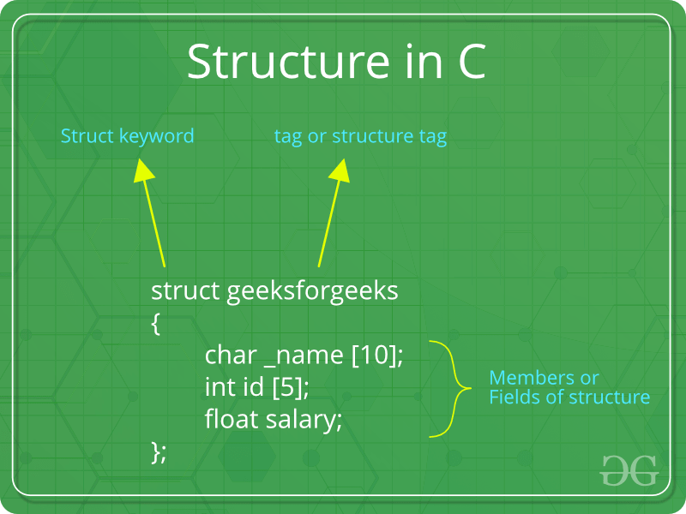
8.1 Introduction
A structure is a key word that create user defined data type in C/C++.
A structure creates a data type that can be used to group items of possibly different types into a single type.

Slide 4
Following is an example:
struct employee
{
int e_id;
char name[50];
float salary;
};

Slide 5
8.2 Declaration and Initialization
A structure variable is a variable of a structure type.
A structure variable can either be declared with structure declaration or as a separate declaration like basic types.
// A variable declaration with structure declaration.
struct Point{
int x, y;
} p1; // The variable p1 is declared with 'Point’
// A variable declaration like basic data types
struct Point{
int x, y;};
int main(){
struct Point p1; // The variable p1 is declared like a normal variable
}

Slide 6
Structure members can be initialized using curly braces ‘{}’.
For example:
struct bankaccount{
int acct_no;
char acct_type;
char name[20];
float balance;
}myaccount={801, ’C’, “Sharat Maharjan”, 8000.0};

Slide 7
LAB 1: WAP to demonstrate initializing structure variable.
#include<stdio.h>
struct student{
int id;
char name[20];
float marks;
char gender;
};
int main(){
struct student s={1,"Sharat Maharjan",80,'M'};
printf("ID = %d",s.id);
printf("\nName = %s",s.name);
printf("\nMarks = %.2f",s.marks);
printf("\nGender = %c",s.gender);
return 0;
}

Slide 8
8.3 Nested Structure
If a structure is defined as member of another structure then it is called nested structure.
The outing structure is called nesting structure and inner is called nested.
For example:
struct person{
char name[20];
struct{
int day;
int month;
int year;
}birthday;
float salary;
}p;
The members contained within the inner structure can be accessed as:
p.birthday.day and so on.

Slide 9
8.4 Array of Structure
Like other primitive data types, we can create an array of structures. For Example:
#include<stdio.h>
struct Point{
int x, y;
};
int main(){
// Create an array of structures
struct Point arr[8];
// Access array members
arr[0].x = 8;
arr[0].y = 20;
printf("%d %d", arr[0].x, arr[0].y);
return 0;}

Slide 10
LAB 2: WAP creating structure named student that has name, roll, marks and remarks as its members. Assume appropriate types and use this structure to read and display records of 5 students.
#include<stdio.h>
struct student{
char name[20];
int roll;
float marks;
char remarks;
};
int main(){
struct student s[5];
int i;
printf("Enter details of 5 students:\n");
for(i=0;i<5;i++){
printf("Name:");
scanf("%s", s[i].name);
printf("Roll:");
scanf("%d", &s[i].roll);
printf("Marks:");
scanf("%f", &s[i].marks);
printf("Remarks:");
scanf(" %c", &s[i].remarks);
}
printf("Details of 5 students:\n");
for(i=0;i<5;i++){
printf("Name = %s \t Roll = %d \t Marks =%f \t Remarks = %c \n", s[i].name, s[i].roll, s[i].marks, s[i].remarks);
}
return 0;
}

Slide 11
8.5 Array within Structure
struct bankaccount{
int acct_no;
char acct_type;
char name[20]; //array within structure
float balance;
}myaccount={801, ’C’, “Sharat Maharjan”, 8000.0};

Slide 12
LAB 3: WAP to read 80 students record with following fields and display the record of BCA faculty only.
#include<stdio.h> #include<string.h> struct student{ int roll; char name[20]; char faculty[20]; struct{ int day; int month; int year; }birthdate; }; int main(){ struct student s[80]; int i; printf("Enter student details:\n"); for(i=0;i<80;i++){ printf("Roll:"); scanf("%d",&s[i].roll); printf("Name:"); | scanf("%s",s[i].name); printf("Faculty:"); scanf("%s",s[i].faculty); printf("Enter day of birth:"); scanf("%d",&s[i].birthdate.day); printf("Enter month of birth:"); scanf("%d",&s[i].birthdate.month); printf("Enter year of birth:"); scanf("%d",&s[i].birthdate.year); } for(i=0;i<80;i++){ if(strcmp(s[i].faculty,"BCA")==0){ printf("Roll = %d \t Name = %s \t Faculty = %s \t Day = %d \t Month = %d \tYear=%d\n",s[i].roll,s[i].name,s[i].faculty,s[i].birthdate.day,s[i].birthdate.month,s[i].birthdate.year); } } return 0; }

Slide 13
8.6 Passing Structure and Array of Structure to function
Structure members can be passed to functions as actual arguments in function call like ordinary variables.
Passing Structure Array of Structure:
It is similar to passing an array of any type to a function.
That is, the name of the array of structure is passed by the calling function which is the base address of the array of structure.

Slide 14
LAB 4: WAP to read name, id and salary of 5 employee and display their details using function.
#include<stdio.h>
struct employee{
char name[20];
int id;
float salary;
};
void display(struct employee []);
int main(){
struct employee e[5];
printf("Enter details of 5 employee:\n");
for(int i=0;i<5;i++){
printf("Name:");
scanf("%s",e[i].name);
printf("ID:");
scanf("%d",&e[i].id);
printf("Salary:");
scanf("%f",&e[i].salary);
}
display(e); //passing address of 1st element of an array of structure
return 0;
}
void display(struct employee e[]){
printf("The details of 5 students:\n");
for(int i=0;i<5;i++){
printf("\nName:%s",e[i].name);
printf("\nID:%d",e[i].id);
printf("\nSalary:%f",e[i].salary);
}
}

Slide 15
8.7 Structure and pointer
LAB 5: Program to demonstrate the use of pointer to structure.
#include<stdio.h>
struct employee{
char name[20];
int id;
float salary;
};
void display(struct employee []);
int main(){
struct employee e[5],*ptr;//*ptr is pointer to structure
ptr=e;
printf("Enter details of 5 employee:\n");
for(int i=0;i<5;i++){
printf("Name:");
scanf("%s",(ptr+i)->name);
printf("ID:");
scanf("%d",&(ptr+i)->id);
printf("Salary:");
scanf("%f",&(ptr+i)->salary);
}
display(e);
return 0;
}
void display(struct employee *p){
printf("The details of 5 students:\n");
for(int i=0;i<5;i++){
printf("\nName:%s",(p+i)->name);
printf("\nID:%d",(p+i)->id);
printf("\nSalary:%f",(p+i)->salary);
}
}

Slide 16
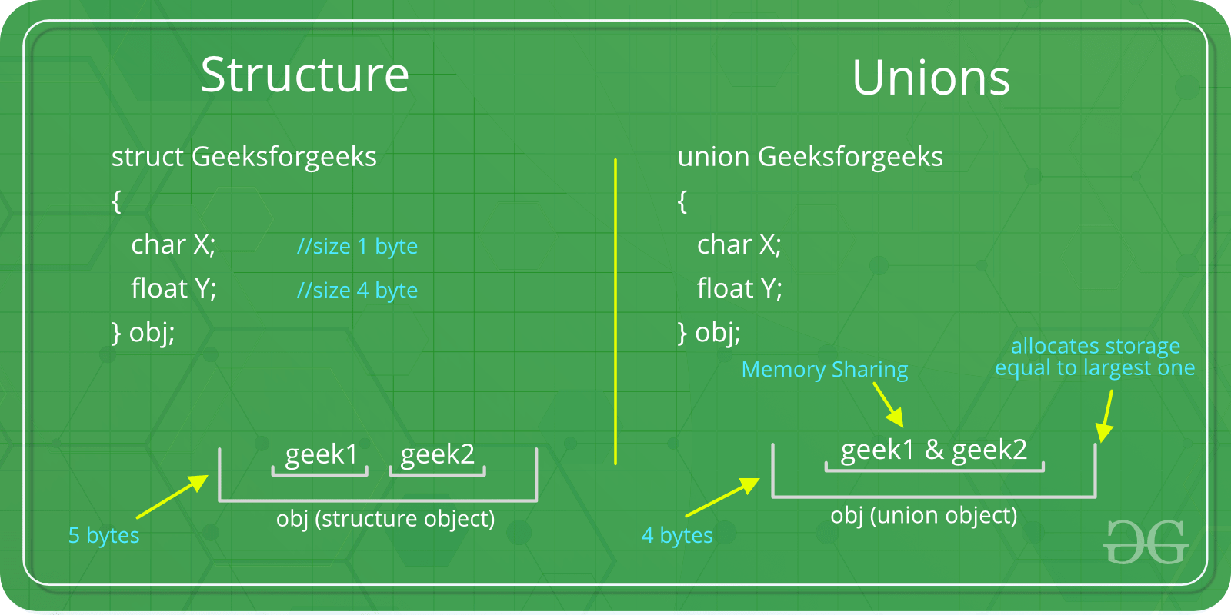
8.8 Union and Its importance
Like Structures, union is a user defined data type.
In union, all members share the same memory location.

Slide 17
Example:
#include <stdio.h>
// Declaration of union is same as structures
union test {
int x, y;
};
int main()
{
// A union variable t
union test t;
t.x = 2; // t.y also gets value 2
printf("x = %d, y = %d\n\n",t.x, t.y);
t.y = 8; // t.x is also updated to 8
printf("x = %d, y = %d\n\n",t.x, t.y);
return 0;
}

Slide 18
Importance of Union:
C unions are used to save memory.
Quite important when memory is valuable, such as in embedded systems.

Slide 19
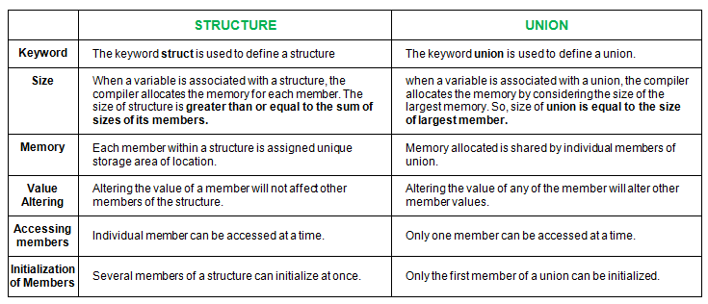

Slide 20
THANK YOU FOR YOUR ATTENTION

